Slide 1
The Chromosomal basis of inheritance.

Slide 2
Introduction
It was not until 1900 that biology finally caught up with Gregor Mendel.
Independently, Karl Correns, Erich von Tschermak, and Hugo de Vries all found that Mendel had explained the same results 35 years before.
Still, resistance remained about Mendel’s laws of segregation and independent assortment until evidence had mounted that they had a physical basis in the behavior of chromosomes.
Mendel’s hereditary factors are the genes located on chromosomes.

Slide 3
Mendelian inheritance has its physical basis in the behavior of chromosomes during sexual life cycles.
Around 1900, cytologists and geneticists began to see parallels between the behavior of chromosomes and the behavior of Mendel’s factors.
  Chromosomes and genes are both present in pairs in diploid cells.
  Homologous chromosomes separate and alleles segregate during meiosis.
  Fertilization restores the paired condition for both chromosomes and genes.

Slide 4
Around 1902, Walter Sutton, Theodor Boveri, and others noted these parallels and a chromosome theory of inheritance began to take form.
The chromosome theory of inheritance states that
  Mendelian genes have specific loci on chromosomes
  Chromosomes undergo segregation and independent assortment

Slide 5
Independent assortment of chromosomes and crossing over produce genetic recombinants.
The production of offspring with new combinations of traits inherited from two parents is genetic recombination.
Genetic recombination can result from independent assortment of genes located on non-homologous chromosomes or from crossing over of genes located on homologous chromosomes.

Slide 6
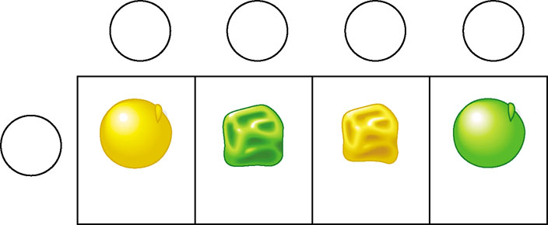
Parental versus recombinant type
Gametes from yellow-round
heterozygous parent (YyRr)
YR
yr
Yr
yR
Gametes from green-
wrinkled homozygous
recessive parent (yyrr)
yr
YyRr
yyrr
Yyrr
yyRr
Parental-
type offspring
Recombinant
offspring

Slide 7
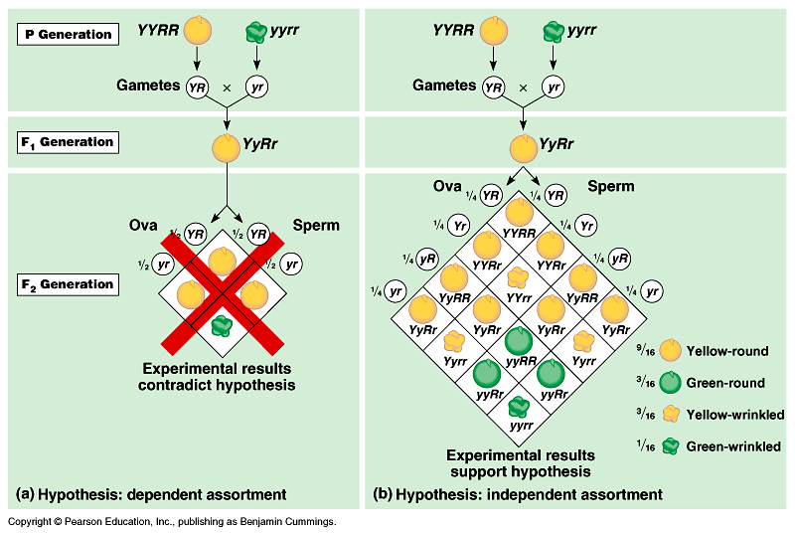

Slide 8
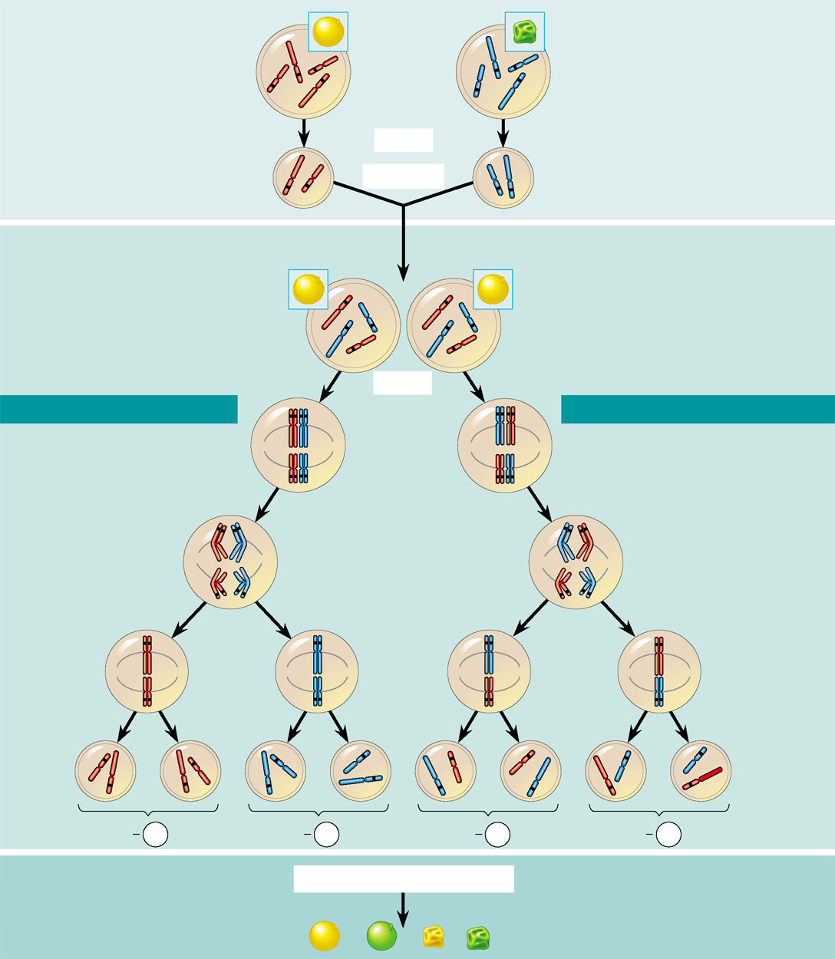
The chromosomal basis of Mendel’s laws
P Generation
Yellow-round
seeds (YYRR)
Green-wrinkled
seeds (yyrr)
Starting with two true-breeding pea plants,
we follow two genes through the F₁ and F₂
generations. The two genes specify seed
color (allele Y for yellow and allele y for
green) and seed shape (allele R for round
and allele r for wrinkled). These two genes are
on different chromosomes. (Peas have seven
chromosome pairs, but only two pairs are
illustrated here.)
Y
y
R
r
Y
R
y
r
Meiosis
R
Y
Fertilization
y
r
Gametes
All F₁ plants produce
yellow-round seeds (YyRr)
F₁ Generation
R
y
R
y
r
r
Y
Meiosis
Y
LAW OF SEGREGATION
R
r
r
R
LAW OF INDEPENDENT ASSORTMENT
Two equally
probable
arrangements
of chromosomes
at metaphase I
Y
y
Y
y
1
1
The R and r alleles segregate
at anaphase I, yielding
two types of daughter
cells for this locus.
Alleles at both loci segregate
in anaphase I, yielding four
types of daughter cells
depending on the chromosome
arrangement at metaphase I.
Compare the arrangement of
the R and r alleles in the cells
on the left and right
R
r
r
R
Anaphase I
Y
y
Y
y
2
R
r
r
R
Each gamete
gets one long
chromosome
with either the
R or r allele.
Metaphase II
2
Each gamete gets
a long and a short
chromosome in
one of four allele
combinations.
Y
y
y
y
Y
Y
Y
Y
Y
Y
y
y
Gametes
R
R
r
r
r
r
R
R
1
4
YR
1
4
yr
1
4
yr
1
4
yR
F₂ Generation
Fertilization among the F₁ plants
3
Fertilization
recombines the
R and r alleles
at random.
3
Fertilization results
in the 9:3:3:1
phenotypic ratio in
the F₂ generation.
9
: 3
: 3
: 1

Slide 9
Morgan traced a gene to a specific chromosome.
Thomas Hunt Morgan was the first to associate a specific gene with a specific chromosome in the early 20th century.
Like Mendel, Morgan made an insightful choice as an experimental animal, Drosophila melanogaster, a fruit fly species that eats fungi on fruit.
  Fruit flies are prolific breeders and have a generation time of two weeks.
  Fruit flies have three pairs of autosomes and a pair of sex chromosomes (XX in females, XY in males).

Slide 10
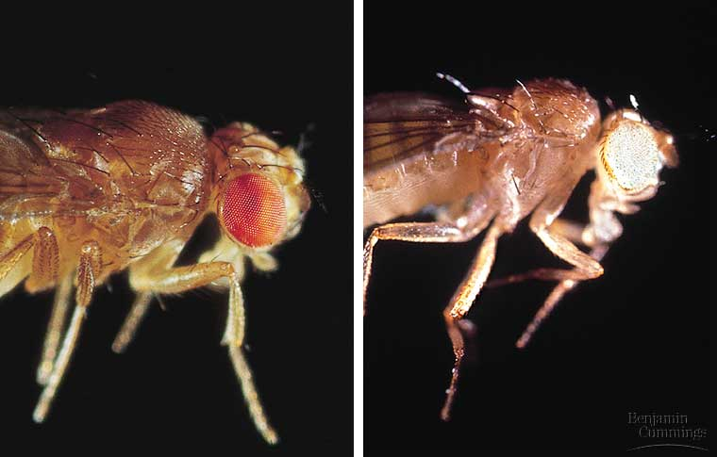
Morgan spent a year looking for variant individuals among the flies he was breeding.
  He discovered a single male fly with white eyes instead of the usual red.
The normal character phenotype is the wild type.
Alternative
traits are
mutant
phenotypes.

Slide 11
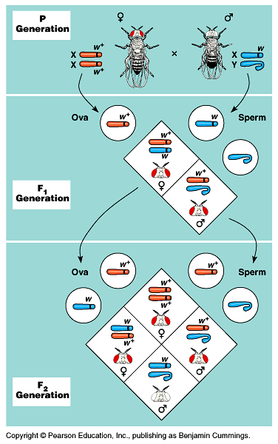
Morgan deduced that the gene with the white-eyed mutation is on the X chromosome alone, a sex-linked gene.
  Females (XX) may have two red-eyed alleles and have red eyes or may be heterozygous and have red eyes.
  Males (XY) have only a single allele and will be red eyed if they have a red-eyed allele or white-eyed if they have a white-eyed allele.

Slide 12
Linked genes tend to be inherited together because they are located on the same chromosome.
Each chromosome has hundreds or thousands of genes.
Genes located on the same chromosome, linked genes, tend to be inherited together because the chromosome is passed along as a unit.
Results of crosses with linked genes deviate from those expected according to independent assortment.

Slide 13
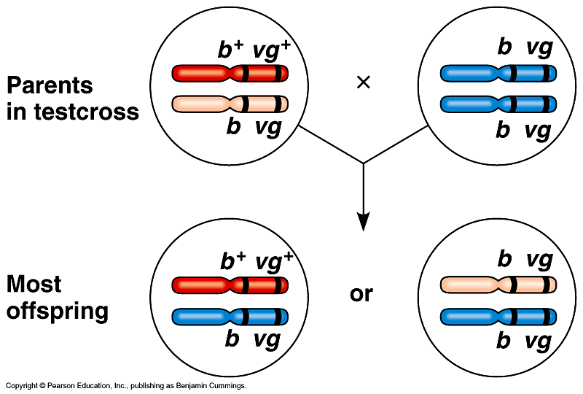
Morgan reasoned that body color and wing shape are usually inherited together because their genes are on the same chromosome.

Slide 14
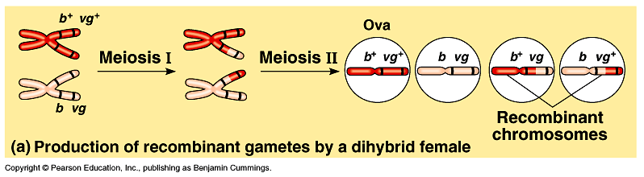
Morgan proposed that some mechanism occasionally exchanged segments between homologous chromosomes.
  This switched alleles between homologous chromosomes.
The actual mechanism, crossing over during prophase I, results in the production of more types of gametes than one would predict by Mendelian rules alone.

Slide 15
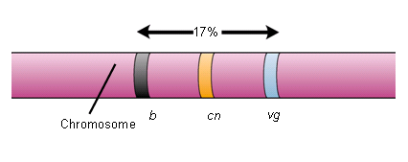

Slide 16
Some genes on a chromosome are so far apart that a crossover between them is virtually certain.
In this case, the frequency of recombination reaches is its maximum value of 50%, and the genes act as if found on separate chromosomes and are inherited independently.
  In fact, several genes studies by Mendel are located on the same chromosome.
    For example, seed color and flower color are far enough apart that linkage is not observed.
    Plant height and pod shape should show linkage, but Mendel never reported results of this cross.

Slide 17
The chromosomal basis of sex varies with the organism.
Although the anatomical and physiological differences between women and men are numerous, the chromosomal basis of sex is rather simple.
In human and other mammals, there are two varieties of sex chromosomes, X and Y.
  An individual who inherits two X chromosomes usually develops as a female.
  An individual who inherits an X and a Y chromosome usually develops as a male.

Slide 18
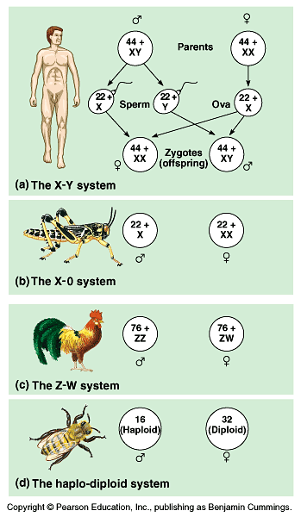
This X-Y system of mammals is not the only chromosomal mechanism of determining sex.
Other options include the X-0 system, the Z-W system, and the haplo-diploid system.

Slide 19
Sex-linked genes have unique patterns of inheritance.
In addition to their role in determining sex, the sex chromosomes, especially the X chromosome, have genes for many characters unrelated to sex.
These sex-linked genes follow the same pattern of inheritance as the white-eye locus in Drosophila.

Slide 20
Errors and Exceptions in Chromosomal Inheritance
Sex-linked traits are not the only notable deviation from the inheritance patterns observed by Mendel.
Also, gene mutations are not the only kind of changes to the genome that can affect phenotype.
Major chromosomal aberrations and their consequences produce exceptions to standard chromosome theory.

Slide 21
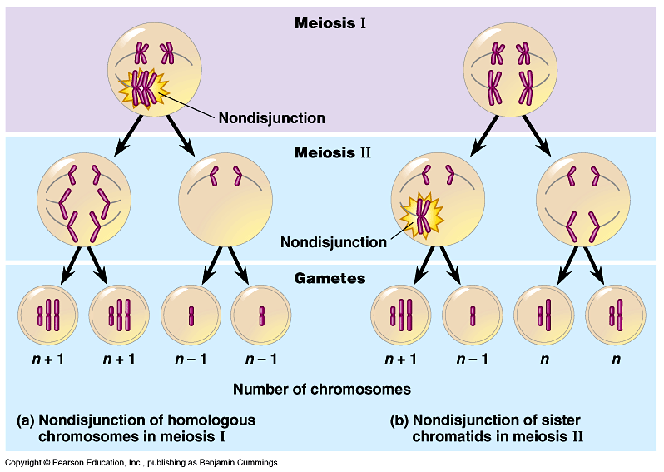
Alterations of chromosome number or structure cause some genetic disorders.
Nondisjunction occurs when problems with the meiotic spindle cause errors in daughter cells.
  This may occur if
  tetrad chromosomes
  do not separate
  properly during
  meiosis I.
  Alternatively, sister
  chromatids may fail
  to separate during
  meiosis II.

Slide 22
As a consequence of nondisjunction, some gametes receive two of the same type of chromosome and another gamete receives no copy.
Offspring results from fertilization of a normal gamete with one after nondisjunction will have an abnormal chromosome number or aneuploidy.
  Trisomic cells have three copies of a particular chromosome type and have 2n + 1 total chromosomes.
  Monosomic cells have only one copy of a particular chromosome type and have 2n - 1 chromosomes.
If the organism survives, aneuploidy typically leads to a distinct phenotype.

Slide 23
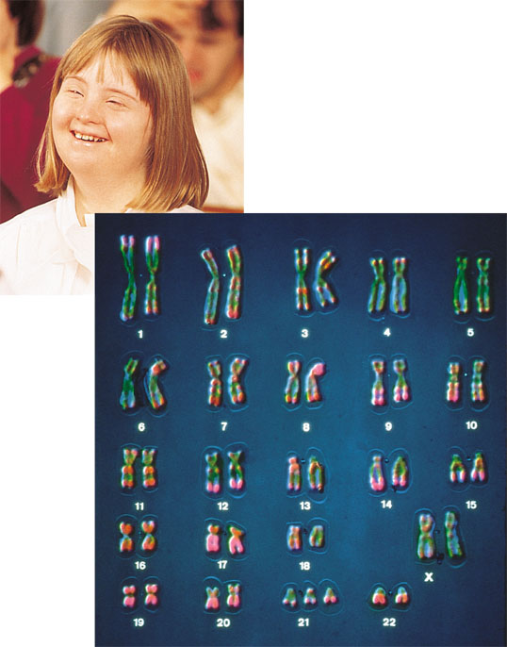
Down Syndrome
Down syndrome
  Is usually the result of an extra chromosome 21, trisomy 21

Slide 24
Organisms with more than two complete sets of chromosomes, have undergone polypoidy.
This may occur when a normal gamete fertilizes another gamete in which there has been nondisjunction of all its chromosomes.
  The resulting zygote would be triploid (3n).
Alternatively, if a 2n zygote failed to divide after replicating its chromosomes, a tetraploid (4n) embryo would result from subsequent successful cycles of mitosis.

Slide 25
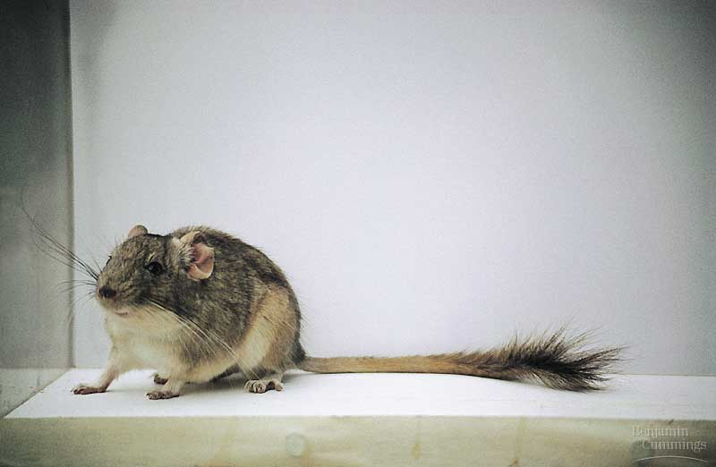
Polyploidy is relatively common among plants and much less common among animals.
  The spontaneous origin of polyploid individuals plays an important role in the evolution of plants.
  Both fishes and amphibians have polyploid species.
  Recently, researchers
  in Chile have
  identified a new
  rodent species
  which may be
  the product of
  polyploidy.

Slide 26
Polyploids are more nearly normal in phenotype than aneuploids.
One extra or missing chromosome apparently upsets the genetic balance during development more than does an entire extra set of chromosomes.

Slide 27
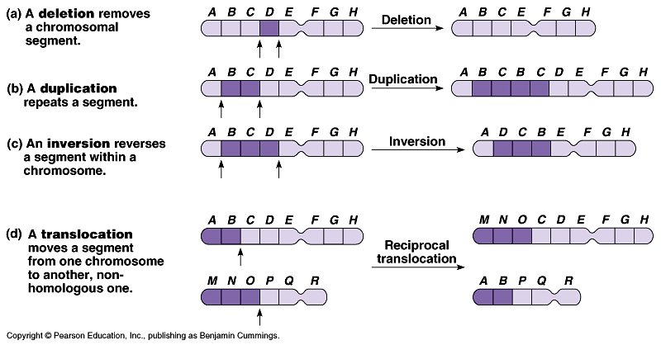
Breakage of a chromosome can lead to four types of changes in chromosome structure.
A deletion occurs when a chromosome fragment lacking a centromere is lost during cell division.
  This chromosome will be missing certain genes.
A duplication occurs when a fragment becomes attached as an extra segment to a sister chromatid.

Slide 28
An inversion occurs when a chromosomal fragment reattaches to the original chromosome but in the reverse orientation.
In translocation, a chromosomal fragment joins a nonhomologous chromosome.
  Some translocations are reciprocal, others are not.

Slide 29
The phenotypic effects of some mammalian genes depend on whether they were inherited from the mother or the father (genomic imprinting).
For most genes it is a reasonable assumption that a specific allele will have the same effect regardless of whether it was inherited from the mother or father.
However, for some traits in mammals, it does depend on which parent passed along the alleles for those traits.
  The genes involved may or may not lie on the X chromosome.
  Involves “essential” silencing of one allele during gamete formation

Slide 30
Two disorders, Prader-Willi syndrome and Angelman syndrome, with different phenotypic effects are due to the same cause, a deletion of a specific segment of chromosome 15.
  Individuals with Prader-Willi syndrome are characterized by mental retardation, obesity, short stature, and unusually small hands and feet.
  These individuals inherit the abnormal chromosome from their father.
  Individuals with Angelman syndrome exhibit spontaneous laughter, jerky movements, and other motor and mental symptoms.
  This is inherited from the mother.

Slide 31
Extra-nuclear genes exhibit a non-Mendelian pattern of inheritance.
Not all of a eukaryote cell’s genes are located in the nucleus.
Extra-nuclear genes are found on small circles of DNA in mitochondria and chloroplasts.
These organelles reproduce themselves.
Their cytoplasmic genes do not display Mendelian inheritance.

Slide 32
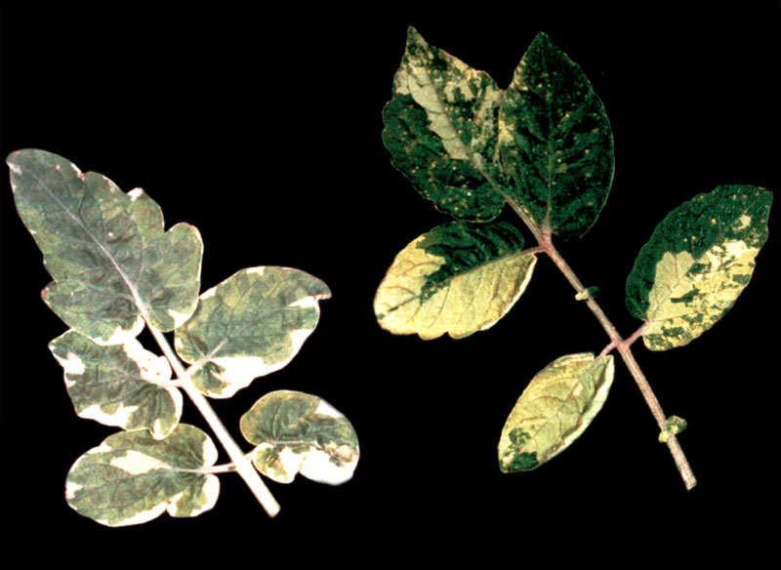
Karl Correns in 1909 first observed cytoplasmic genes in plants.
He determined that the coloration of the offspring was determined only by the maternal parent.
These coloration patterns are due to genes in the plastids which are inherited only via the ovum, not the pollen.

Slide 33
Because a zygote typically inherits all its mitochondria/chloroplasts only from the ovum, all such genes in demonstrate maternal inheritance.
Several rare human disorders are produced by mutations to mitochondrial DNA.
  These primarily impact ATP supply by producing defects in the electron transport chain or ATP synthase.
  Tissues that require high energy supplies (for example, the nervous system and muscles) may suffer energy deprivation from these defects.
  Other mitochondrial mutations may contribute to diabetes, heart disease, and other diseases of aging.

Slide 34
X inactivation in Female Mammals
In mammalian females
  One of the two X chromosomes in each cell is randomly inactivated during embryonic development

Slide 35
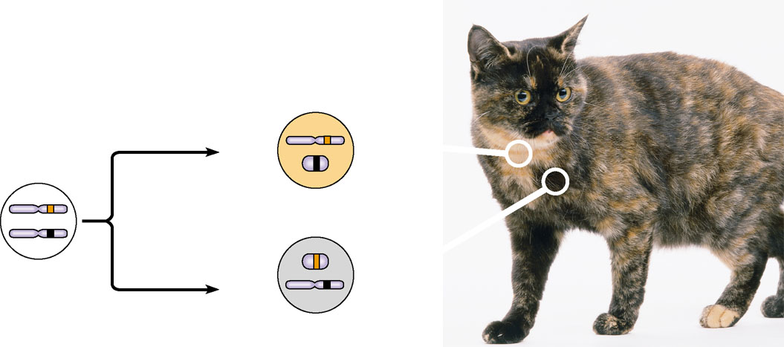
Two cell populations
in adult cat:
Active X
Early embryo:
Orange
fur
X chromosomes
Cell division
and X
chromosome
inactivation
Inactive X
Inactive X
Black
fur
Allele for
black fur
Active X

